Slide 1
Advanced Heart Health Assessment through Machine Learning using KNN Algorithm
PIP104 PROFESSIONAL PRACTICE-II
VIVA-VOCE
Batch Number: G39
Roll Number | Student Name
Under the Supervision of,
Dr. Prakash Shanmurthy
Assistant Professor
School of Computer Science Engineering & Information Science
Presidency University
20201CSE0207 Surag Nekkanti
20201CSE0255 Navaneeth N Y
20201CSE0237 Shaun Joe Roy
20201CSE0200 Gautham R Ganesh

Slide 2
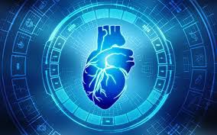
Introduction
The heart is a vital organ responsible for pumping blood. Heart disease, like Coronary Artery Disease (CAD) and heart failure, is a major health concern.
Machine Learning is one of the efficient techniques for the testing, which is based on training and testing[1].
These models can help in early diagnosis, risk assessment, and personalized treatment plans for individuals at risk of heart diseases.
As in Ml, there are likely to be four major algorithms comparison done in the terms of accuracy of predictions of a heart disease in the below sections[2].
Hence it’s found out that the most and accurate ML algorithm that can be used for predicting the heart disease is the K-Nearest Neighbour algorithm.

Slide 3
Literature Review
This literature review provides a brief overview of studies related to heart disease prediction using ML. Machine learning techniques have become increasingly prevalent in healthcare applications due to their ability to analyze large datasets and discover complex patterns.
The early and accurate prediction of heart disease is critical for improving patient outcomes and reducing healthcare costs. Machine learning has emerged as a powerful tool in healthcare for predicting heart disease[3].
ML can be applied to various aspects of heart disease prediction, from risk assessment to diagnosis and treatment planning. Machine learning holds substantial promise in enhancing the accuracy of heart disease prediction.
As research in this field progresses, the potential for earlier diagnosis and more effective prevention and treatment of heart disease continues to grow[4].

Slide 4
Literature Review
Summarize various studies and their outcomes related to predicting heart disease using KNN. Highlight different datasets, preprocessing techniques, and feature selection methods employed in these studies.
Explore recent advancements in KNN-based heart disease prediction, such as hybrid models combining KNN with other algorithms or incorporating deep learning techniques. Discuss potential future research directions in this field[5].
Sum up the key findings from the reviewed literature, emphasizing the strengths and weaknesses of using the KNN algorithm for heart disease prediction. Highlight the gaps in existing research that could be explored in future studies.

Slide 5
Research Gaps Identified
Present in the Hospitals Prediction of Heart Disease using ML is not used,Predicting weather the person has Heart Disease or no Heart Disease is checked by ECG, 2D Echo, Threadmill Test, Blood Test etc.
In this model we can check weather the person has Heart Disease or no Heart Disease by entering the values to the attributes.
This model can be used in any Blood Test centeres and Hospitals as it can help people while giving blood test and getting the report.
It can be usefull for people staying in villages as they can come to the nearby Hospital and Blood Test Centere during Emergency.

Slide 6
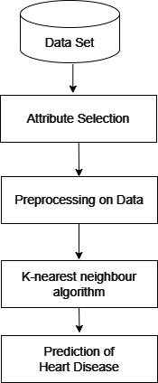
Block Diagram(Proposed Method)

Slide 7
Proposed Methodology
The proposed method aims to address the critical issue of heart disease prediction and diagnosis.
K-Nearest Neighbour Algorithm is one of the most effective and accurate Machine Learning algorithm for the prediction of heart disease.
The steps involved are-
i) Data Set(Patient Details)
ii) Attribute Selection
iii) Pre Processing on Data
iv) Algorithm selection(KNN algorithm)

Slide 8
Objectives
The Primary objectives are :-
To predict heart disease using K-Nearest Neighbour.
To detect heart disease in the early stage to prevent further complication.
Detecting Heart Disease in the early stage reduces the cost for
the individual.

Slide 9
System Design & Implementation
1.0 Overview: The system design phase is crucial in developing a robust heart disease prediction model. The encompasses key components such as- Data collection, Preprocessing, Model Selection and Training.
1.1 Data Collection: We gather a comprehensive dataset with diverse features like age, sex, blood pressure, and cholesterol levels. The source in this particular project is a dataset from the UCI repository.

Slide 10
System Design & Implementation
1.2 Data Preprocessing:
Implement feature scaling to normalize numerical values, preventing dominance by certain features.
1.3 Model Selection:
Choose the k-Nearest Neighbors (KNN) algorithm for its simplicity and effectiveness in classification tasks.
Experiment with different values of k to find the optimal balance between bias and variance.
1.4 Model Training:
Train the KNN model using the training dataset, utilizing the selected features to predict the presence or absence of heart disease.
Evaluate the model's performance on the training set to assess its baseline accuracy.

Slide 11
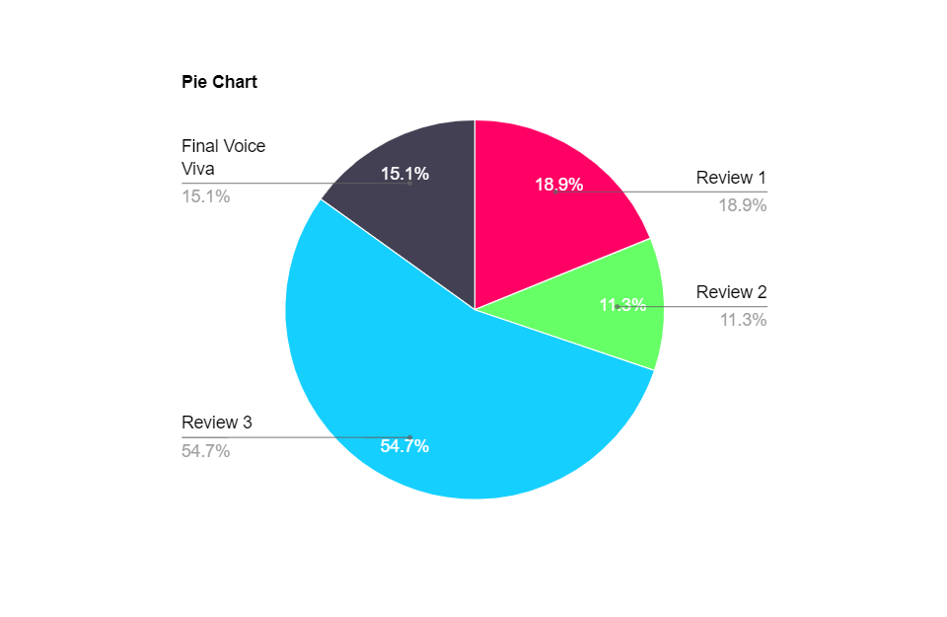
Timeline of Project
Review 1 => 10-11-2023
Review 2 => 6-12-2023
Review 3 => 29-12-2023
Final Voice Viva => 8-1-2024

Slide 12
Outcomes / Results Obtained
Early Intervention: ML models can help in identify individuals at high risk of heart disease early, allowing for timely interventions, lifestyle modifications and medical treatments to prevent or manage the condition effectively.
Reduction in Mortality: Early detection and personalized interventions will significantly reduce the mortality rates associated with heart diseases, leading to improved overall survival rates among patients.
Cost Savings: Early identification and preventive measures can reduce the healthcare costs in the long run by minimizing the need for expensive health treatments, surgeries, and hospitalizations associated with advanced stages of heart diseases.
Personalized Treatment Plans: ML-based predictions enable the customization of treatment plans based on individual patient profiles, leading to more effective and tailored healthcare solutions.

Slide 13
Conclusion
In conclusion, the prediction of heart disease using machine learning holds immense promise in revolutionizing healthcare
These outcomes not only lead to improved patient outcomes, reduce mortality rates, and enhanced quality of life but also to contribute to substantial cost savings and public health impact.
As research and technology progress, the accuracy and efficiency of heart disease predictions are expected to further improve, making a significant difference in the lives of individuals at risk.
After Comparing all the algorithms it is found KNN is the most accurate and efficient algorithm.

Slide 14
References
[1] A. Singh and R. Kumar, "Heart Disease Prediction Using Machine Learning Algorithms," 2020 International Conference on Electrical and Electronics Engineering (ICE3),
Gorakhpur, India, 2020, pp. 452-457, doi: 10.1109/ ICE348803.2020.9122958.
[2] A. Srivastava and A. k. Singh, "Heart Disease Prediction using Machine Learning," 2022 2nd International Conference on Advance Computing and Innovative
Technologies in Engineering (ICACITE), Greater Noida, India, 2022, pp. 2633-2635, doi: 10.1109/ICACITE53722.2022.9823584.
[3] M. R. Singh, A. Sharma and D. Singh, "Heart Disease Prediction Using Machine Learning Algorithm," 2021 3rd International Conference on Advances in
Computing, Communication Control and Networking (ICAC3N), Greater Noida, India, 2021, pp. 455-460, doi: 10.1109/ICAC3N53548.2021.9725735.
[4] G. Kumar Sahoo, K. Kanike, S. K. Das and P. Singh, "Machine Learning-Based Heart Disease Prediction: A Study for Home Personalized Care," 2022 IEEE
32nd International Workshop on Machine Learning for Signal Processing (MLSP), Xi'an, China, 2022, pp. 01-06, doi: 10.1109/ MLSP55214.2022.9943373.
https://archive.ics.uci.edu/ml/datasets/Heart+Disease

Slide 15
References
[5] M. Nikhil Kumar, K. V. S. Koushik, K. Deepak, “Prediction of Heart Diseases Using Data Mining and Machine Learning Algorithms and Tools” International Journal of Scientific Research in Computer Science, Engineering and Information Technology ,IJSRCSEIT 2019.
[6] Amandeep Kaur and Jyoti Arora,“Heart Diseases Prediction using Data Mining Techniques: A survey” International Journal of Advanced Research in Computer Science , IJARCS 2015-2019.
[7] Pahulpreet Singh Kohli and Shriya Arora, “Application of Machine Learning in Diseases Prediction”, 4th International Conference on Computing Communication And Automation(ICCCA), 2018.
[8] M. Akhil, B. L. Deekshatulu, and P. Chandra, “Classification of Heart Disease Using K- Nearest Neighbor and Genetic Algorithm,” Procedia Technol., vol. 10, pp. 85–94, 2013.
[9] S. Kumra, R. Saxena, and S. Mehta, “An Extensive Review on Swarm Robotics,” pp. 140–145, 2009.
[10] Hazra, A., Mandal, S., Gupta, A. and Mukherjee, “ A Heart Disease Diagnosis and Prediction Using Machine Learning and Data Mining Techniques: A Review” Advances in Computational Sciences and Technology , 2017.

Slide 16
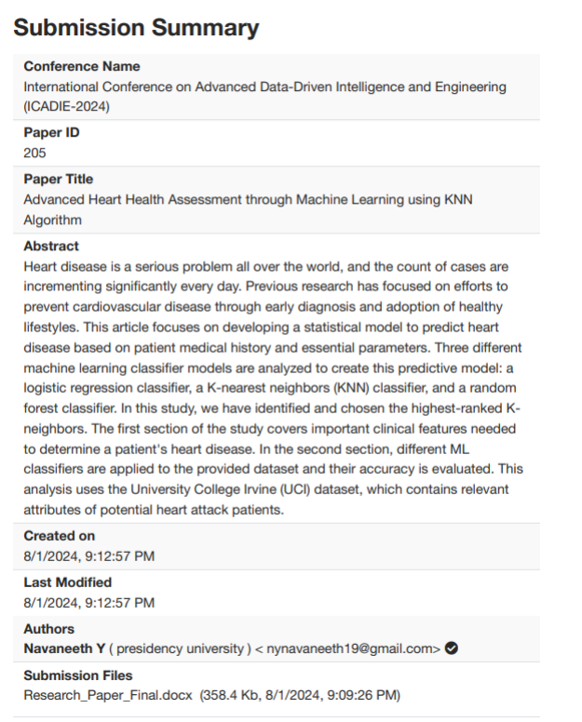
Publication Details

Slide 17
Achievements (if any)

Slide 18

Thank You

